Slide 1
CSC 017: Fundamentals of Computer Science III: Advanced Data Structures and Object-Oriented Programming Midterm Exam Spring 2025
Department of Computer Science,
Hofstra University

Slide 2
Q1. Multiple-choice (15 pts)
1. Consider the following functions from positives integers to real numbers (√n denotes SquareRoot(n)): 10, √n, n, log₂n, 100/n.
The correct arrangement of the above functions in increasing order of asymptotic complexity is:
(A) log₂n, 100/n, 10, √n, n
(B) 100/n, 10, log₂n, √n, n
(C) 10, 100/n, √n, log₂n, n
(D) 100/n, log₂n, 10, √n, n
ANS: B
2. Consider the following three functions: f₁ = 10ⁿ f₂ = n^(log n) f₃ = n^(√n)
Which one of the following options arranges the functions in the increasing order of asymptotic complexity?
(A) f₃, f₂, f₁ (B) f₂, f₁, f₃ (C) f₁, f₂, f₃ (D) f₂, f₃, f₁
ANS: D
3. What is the time complexity of function f1(n) and function f2(n), respectively?
void f1(n){
for (int i = 0; i < n; i+=5) {
// O(1)
}
}
void f2(n){
for (int i = 1; i < n; i*=5) {
// O(1)
}
}
A) O(\log n), O(\log n)
B) O(\log n), O(n)
C) O(n), O(\log n)
D) O(n), O(n)
Answer: C
4. What does the regular expression pattern ^[0-9]+$ match?
A) A string containing at least one digit
B) A string starting with a digit
C) A string ending with a digit
D) A string containing only digits
Answer: A or D
5. Which of the following regular expressions matches exactly three consecutive lowercase letters?
A) [a-z]{3}
B) [a-z]{1,3}
C) [a-z]{3,}
D) [a-z]{0,3}
Answer: A
6. What does the regular expression [^abc] match?
A) Either a, b, or c
B) Any character that is not a, b, or c
C) The beginning of a string followed by a, b, or c
D) The characters 'a', 'b', and 'c' only when they appear together
Answer: B
7. Which regular expression correctly matches a valid email address format (username@domain.com)?
A) [a-zA-Z0-9]+@[a-zA-Z0-9]+.[a-zA-Z]{2,}
B) [a-zA-Z0-9]@[a-zA-Z0-9].[a-zA-Z]
C) [a-zA-Z0-9]@[a-zA-Z0-9].[a-zA-Z]*
D) .+@.+..+
Answer: A
8. Which regular expression matches a string that contains either "cat" or "dog"?
A) cat|dog
B) (cat)(dog)
C) cat+dog
D) [cat|dog]
Answer: A
9. Which of the following would match a string containing at least one digit?
A) \d+
B) \d{1,}
C) \d?
D) Both A and B
Answer: D
10. What does the regular expression \b[A-Z][a-z]*\b match?
A) Any capitalized word (a word that starts with an uppercase letter followed by zero or more lowercase letters)
B) Any word containing at least one uppercase letter in it
C) Any word written entirely in uppercase
D) Any word with exactly one uppercase letter in it
Answer: A

Slide 3
Q1. Multiple-choice (15 pts)
11. Primary clustering in linear probing occurs because:
A) Hash functions produce sequential indices
B) Collisions form long contiguous blocks
C) Table size is a prime number
D) Keys are not uniformly distributed
Answer: B
12. Quadratic probing uses which probe sequence?
A) h+1, h+2, h+3,...
B) h+1², h+2², h+3²,...
C) h+hash2(key), 2*hash2(key),...
D) Random permutation
Answer: B
13. Which of the following is NOT a method to mitigate primary clustering?
A) Better-designed hash function
B) Alternative probing methods
C) Resizing the hash table
D) Using a binary search tree
Answer: D
14. Suppose the numbers 7, 5, 1, 8, 3, 6, 0, 9, 4, 2 are inserted in that order into an initially empty Binary Search Tree. What is the in-order traversal of the resultant tree?
A) 7 5 1 0 3 2 4 6 8 9
B) 0 2 4 3 1 6 5 9 8 7
C) 0 1 2 3 4 5 6 7 8 9
D) 9 8 6 4 2 3 0 1 5 7
ANS: C
15. A full binary tree with height 3 has how many nodes?
A) 7
B) 15
C) 31
D) 8
Answer: B 15 [Formula: n=2^(h+1)−1 for h=3]

Slide 4
Q1 Multiple-choice questions: enter your answer keys here:
1 | 2 | 3 | 4 | 5 | 6 | 7 | 8 | 9 | 10
B | D | C | A or D | A | B | A | A | D | A
11 | 12 | 13 | 14 | 15
B | B | D | C | B

Slide 5
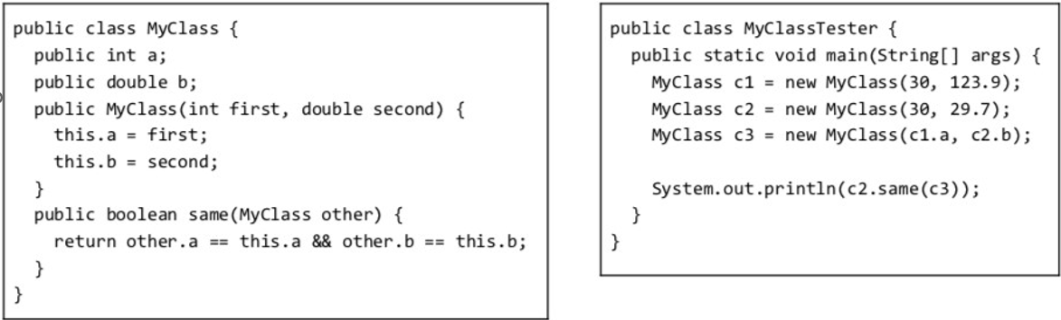
Q2 Lecture 3-inheritance and polymorphism
a) (1 pts) What does the main method of MyClass Tester print?
ANS: true, since both c2 and c3 have member variables a=30 and b=29.7

Slide 6
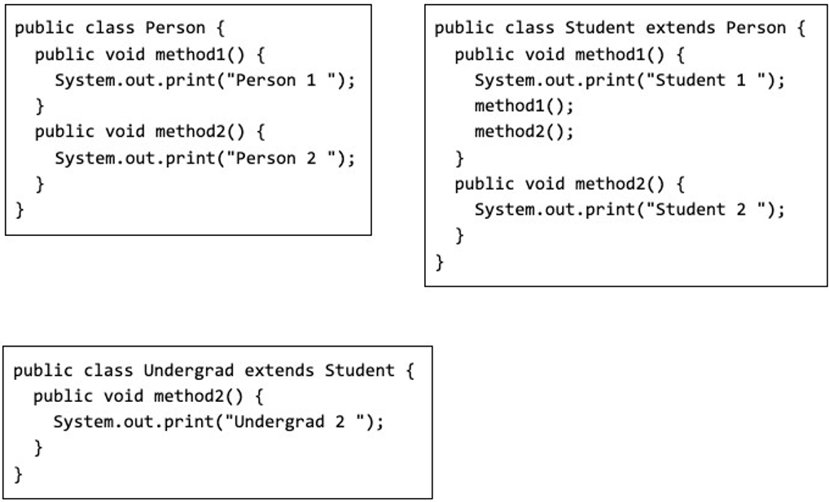
Q2 Lecture 3-inheritance and polymorphism
b) (4 pts) Consider the following class definitions:
b1) What does the following program print? Explain why.
ANS: Infinite recursive calling of method1() to print “Student 1” repeatedly. Since the actual object type is Undergrad, but method1() is not defined in class Undergrad, so the method1() defined its parent class will be called to print “Student 1” in an infinite recursion.
b2) What does the following program print? Explain why.
ANS: It prints “Undergrad 2”. Since the actual object type is Undergrad, the method2() defined in class Undergrad will be called to print “Undergrad 2”.
Person u = new Undergrad();
u.method1();
Person u = new Undergrad();
u.method2();

Slide 7
Q3. Lecture 5-algorithm performance analysis (10 pts)
For each function f(n) below, give an asymptotic upper bound using big-O notation. You should give the tightest bound possible (so giving O(2^{n}) for every question is unlikely to result in many points).
f(n) = 1000000
f(n) = n⁴ +100n³ +14n²
f(n) = 2^{n} +100n³ +14n²
f(n) = 100n³ + 14n²
f(n) = 7n² + 14n
f(n) = log(7n²)
f(n) = 5loglogn + 4log(n)*log(n)
f(n) = .001n + 100*2^{n}
f(n) = n³(1 + 6n + 2014n²)
f(n) = (logn)(n + n²)
O(1)
O(n⁴)
O(2^{n})
O(n³)
O(n²)
O(logn)
O(log² n)
O(2^{n})
O(n⁵)
O(n² logn)

Slide 8
Q4. Lecture 7-hash table (20 pts)
Insert the following six keys in this order: 19, 48, 8, 27, 97, 7 into a hash table of size 10, where the hash function is modulo table size (%10).
a) (1 pts) What is the load factor?
ANS: Load factor = number of keys / size of hash table = 6/10 = 0.6
b) (3 pts) Fill in the table, resolving hash collisions with linear probing. (Fill in the table without detailed steps.)
ANS:
19 (insert at index 9)
48 (insert at index 8)
8 (collision with 48). Insert at index 0
27 (insert at index 7)
97 (collision with 27). Insert at index 1
7 (collision with 27). Insert at index 2
0 | 1 | 2 | 3 | 4 | 5 | 6 | 7 | 8 | 9
8 | 97 | 7 |  |  |  |  | 27 | 48 | 19

Slide 9
Q4. Lecture 7-hash table (20 pts)
c) (4 pts) Fill in the table, resolving hash collisions with quadratic probing. (Show the probe sequence for resolving collisions.)
ANS:
19 (insert at index 9)
48 (insert at index 8)
8 (collision with 48 at index 8)
(8 + 1^2) % 10 = 9 (collision with 19)
(8 + 2^2) % 10 = 2. Insert at index 2
27 (insert at index 7)
97 (collision with 27 at index 7)
(7 + 1^2) % 10 = 8 (collision with 48)
(7 + 2^2) % 10 = 1 (empty). Insert at index 1
7 (collision with 27 at index 7)
(7 + 1^2) % 10 = 8 (collision with 48)
(7 + 2^2) % 10 = 1 (collision with 97)
(7 + 3^2) % 10 = 6 (empty). Insert at index 6
0 | 1 | 2 | 3 | 4 | 5 | 6 | 7 | 8 | 9
 | 97 | 8 |  |  |  | 7 | 27 | 48 | 19

Slide 10
Q4. Lecture 7-hash table (20 pts)
d) (8 pts) Fill in the table, resolving hash collisions with double hashing with two hash functions:
h1(k)=x%10 (primary hash), h2(k)=1+(x%7) (secondary hash), Probing formula:
Probe(k, i)=(h1(k)+i⋅h2(k))%10, i=0, 1, 2… (Show the probe sequence for resolving collisions.)
19 (insert at index 9)
48 (insert at index 8)
8 (collision with 48 at index 8)
h₂(8)=1+(8%7)=2. Next probe: (8 + 1·2)%10 = 0 (insert at index 0)
27 (insert at index 7)
97 (collision with 27 at index 7)
h₂(97)=1+(97%7)=7. Next probe: (7 + 1·7)%10 = 4 (insert at index 4)
7 (collision with 27 at index 7)
h₂(7)=1+(7%7)=1. Next probes:
i=1: (7 + 1·1)%10 = 8 (collision with 48)
i=2: (7 + 2·1)%10 = 9 (collision with 19)
i=3: (7 + 3·1)%10 = 0 (collision with 8)
i=4: (7 + 4·1)%10 = 1 (insert at index 1)
0 | 1 | 2 | 3 | 4 | 5 | 6 | 7 | 8 | 9
8 | 7 |  |  | 97 |  |  | 27 | 48 | 19

Slide 11
Q4. Lecture 7-hash table (20 pts) (with typo)
(The exam paper had a typo Probe(k, i)=(h1(k)+i⋅h2(k))%7. Despite this typo, it is still a valid hash function and you can still solve this problem based on this probe function. Students who give either solution is given full credit.)
d) (8 pts) Fill in the table, resolving hash collisions with double hashing with two hash functions:
h1(k)=x%10 (primary hash), h2(k)=1+(x%7) (secondary hash), Probing formula:
Probe(k, i)=(h1(k)+i⋅h2(k))%7, i=0, 1, 2… (Show the probe sequence for resolving collisions.)
19 (insert at index 9)
48 (insert at index 8)
8 (collision with 48 at index 8)
h₂(8)=1+(8%7)=2. Next probe: (8 + 1·2)%7 = 3 (insert at index 3)
27 (insert at index 7)
97 (collision with 27 at index 7)
h₂(97)=1+(97%7)=7. Next probe: (7 + 1·7)%7 = 0 (insert at index 0)
7 (collision with 27 at index 7)
h₂(7)=1+(7%7)=1. Next probe: (7 + 1·1)%7 = 1 (insert at index 1)
0 | 1 | 2 | 3 | 4 | 5 | 6 | 7 | 8 | 9
97 | 7 |  | 8 |  |  |  | 27 | 48 | 19

Slide 12
Q4: Separate Chaining
e) (2 pts) Fill in the table, resolving hash collisions with separate chaining into a sorted linked list (with the smallest element at the head of the list). (Fill in the table without detailed steps.)
ANS: Upon hash collision, put the item into a sorted linked list in the index.
0 | 1 | 2 | 3 | 4 | 5 | 6 | 7 | 8 | 9
 |  |  |  |  |  |  | 7,27,97 | 8,48 | 19

Slide 13
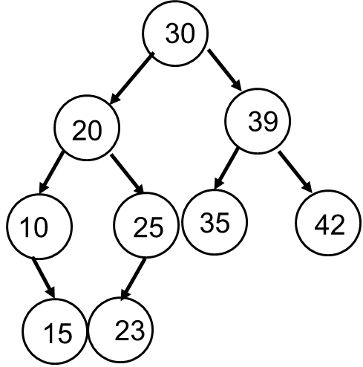
Q5. Lecture 8-binary search tree (40 pts)
a) (15 pts) The Pre-order traversal sequence of a Binary Search Tree is 30, 20, 10, 15, 25, 23, 39, 35, 42. Construct the tree and give its in-order and post-order traversals. Show the detailed steps.
ANS: Given:
Pre-order: 30 20 10 15 25 23 39 35 42
In-order: 10 15 20 23 25 30 35 39 42
We can construct the tree and derive the post-order
Post-order: 15 10 23 25 20 35 42 39 30

Slide 14
Q5. Lecture 8-binary search tree (40 pts)
a) Explanations:
Pre-order: 30 20 10 15 25 23 39 35 42
In-order: 10 15 20 23 25 30 35 39 42
1. Root Identification: The first element in pre-order (30) is the root.
2. Subtree Division:
- In in-order traversal, elements before 30 (10 15 20 23 25) form the left subtree, and elements after (35 39 42) form the right subtree.
3. Left Subtree Construction:
- Pre-order segment for left: 20 10 15 25 23
- Root is 20 (first in pre-order). In in-order (10 15 20 23 25), left of 20 is (10 15) and right is (23 25).
- Pre-order segment (10 15): root is 10, and 15 is its right child
- Pre-order segment (25 23): root is 25, and 23 is its left child
4. Right Subtree Construction:
- Pre-order segment for right: (39 35 42)
- Root is 39 (first in pre-order). In in-order (35 39 42), 39 has a left child 35 and right child 42.
We can draw the tree now and derive the post order traversal 15 10 23 25 20 35 42 39 30.

Slide 15
Q5. Lecture 8-binary search tree (40 pts)
b) (5 pts) Given this Binary Search Tree, draw the resulting Binary Search Tree after deleting node 15. There are two possible results, and please draw both of them.
20
20
20
15
30
30
16
30
Delete 15
12
OR
10
17
10
17
10
17
2
12
16
19
2
16
19
2
12
19

Slide 16
Q5. Lecture 8-binary search tree (40 pts)
c) (20 pts) Fill in the labels A, B in each node in the following Binary Trees so they all have either:
(1) breadth-first (level-order) traversal of AB
or (2) pre-order traversal of AB
or (3) In-order traversal of AB
or (4) post-order traversal of AB
or (5) they are all Binary Search Trees, considering A < B
or (6) they are all Binary Min-Heaps, considering A < B

Slide 17
(1) breadth-first (level-order) traversal of AB
A
A
B
B

Slide 18
(2) pre-order traversal of AB
A
A
B
B

Slide 19
(3) In-order traversal of AB
A
B
B
A

Slide 20
(4) post-order traversal of AB
B
B
A
A

Slide 21
(5) they are all Binary Search Trees, considering A < B
A
B
B
A

Slide 22
(6) they are all Binary Min-Heaps, considering A < B
A
A
B
B

Slide 23
Q6 Lecture 9-self balancing trees (20 pts)
a) (10 pts) Create an AVL Tree by inserting the sequence: 6, 5, 4, 3, 7, 8. Draw a new figure whenever you do a rotation. (Do not write out the AVL invariant at each step, just draw the tree at each step.) (If you run out of space, use back of the paper.)

Slide 24
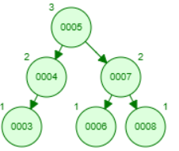
AVL Tree: Inserting the sequence: 6, 5, 4, 3, 7, 8
5
6
5
Insert 6,5,4
Right rotation
Insert 3,7
4
6
5
4
6
3
7
4
5
Left rotation
(6 is lowest unbalanced node.)
5
Insert 8
4
6
7
4
3
7
6
8
3
8

Slide 25
Q6 Lecture 9-self balancing trees (20 pts)
b) (10 pts) Create a Red-Black Tree by inserting the sequence: 6, 5, 4, 3, 7, 8. Draw a new figure whenever you do a rotation and/or recoloring. Mark each node as r for read, or b for black. (If you run out of space, use back of the paper.)
Notes:
This is the kink case

Slide 26
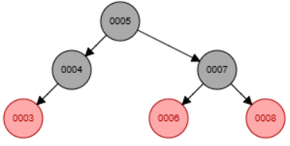
Red-Black Tree: Inserting the sequence: : 6, 5, 4, 3, 7, 8
5
6
Right rotation
Recolor
5
Insert 6,5,4
Insert 3
4
6
5
4
6
4
3
Left rotation
Recolor
5
5
5
5
Recolor
Insert 7
Insert 8
4
6
6
4
4
7
4
6
3
7
7
3
3
6
8
3
8

Slide 27
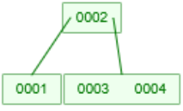
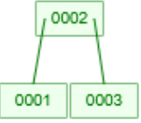


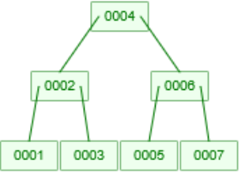
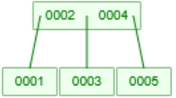
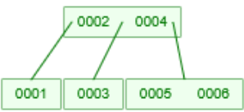
Q X Lecture 10-2-3 Trees B Trees
Insert keys 1, 2, 3, 4, 5, 6, 7 into an initially-empty 2-3 tree. Show the resulting 2-3 tree after inserting each key. (No need to show intermediate states with temporary 4-nodes.)
Insert 1
Insert 3
Insert 4
Insert 2
Insert 5
Insert 6
Insert 7

Slide 28
QX L11 Heaps
Consider the following sequence of numbers: 4, 3, 2, 1, 5, 0. Build a binary min-heap with these numbers in two ways.
(a) Use Floyd’s build-heap algorithm. Draw the heap before and after each percolation. At the end, give the array representation of the final heap.
4
Percolate down
at level 2
4
Percolate down
at level 1
0
3
2
1
0
1
2
1
5
0
3
5
2
3
5
4
Array representation
0 | 1 | 2 | 3 | 5 | 4

Slide 29
L11 Heaps ANS
Consider the following sequence of numbers: 4, 3, 2, 1, 5, 0. Build a binary min-heap with these numbers in two ways.
(b) Build the heap using repeated insertions (in the order given: 4, 3, 2, 1) - draw the heap after each insertion. At the end, draw the array representation of the final heap.
1
1
3
2
Add 3
percolate up
Add 2
percolate up
Add 1
percolate up
Add 5
2
3
2
3
4
4
4
3
4
4
5
0
Add 0
percolate up
2
1
Array representation
0 | 2 | 1 | 4 | 5 | 3
4
5
3

Slide 30
Q. Quick Sort
Sort this array of numbers with In-Place QuickSort into ascending order, using the first number of each subarray as the pivot. Show the intermediate subarrays at each step, enclosing the pivot at each step with parentheses. Draw the corresponding Binary Search Tree and give the final sorted array.
5, 4, 3, 2, 1, 0

Slide 31
Q. Quick Sort ANS
Red numbers indicate remaining subarray to be sorted. In this example, every time the pivot has either left or right subarray as null, so only one subarray is left after each step.
5 as pivot
5 | 4 | 3 | 2 | 1 | 0
0 | 4 | 3 | 2 | 1 | 5
Swap 5 and 0
0 as pivot
4 as pivot
0 | 4 | 3 | 2 | 1 | 5
Swap 4 and 1
0 | 1 | 3 | 2 | 4 | 5
No swap
1 as pivot
3 as pivot
0 | 1 | 3 | 2 | 4 | 5
0 | 1 | 2 | 3 | 4 | 5
No swap
Swap 3 and 2

Slide 32
Q. Quick Sort ANS
5
0
4
1
3
1

Slide 33
Red numbers indicate remaining subarray to be sorted. In this example, every time the pivot has either left or right subarray as null, so only one subarray is left after each step.

